Slide 1
Industrial Training
Mern Stack

Slide 2
Languages & Framwork Used
FRONTEND
HTML 5
CSS 3
BOOTSTRAP 4
JAVASCRIPT
REACT-JS
BACKEND
NODE-JS
EXPRESS-JS
DATABASE
MONGODB ATLAS

Slide 3
Project
Property Dekho

Slide 4
Introduction
Property Dekho Project is a dynamic website for property business.
Property Dekho Project allows the user to access all the details of property like price, location, owner, amenites, etc.
The main purpose is to help the user to find its desired property and admin to easilly shortlist its property to wide range of customers.
The can used by both user and admin.

Slide 5
Problem Statement
The purpose of this website is on established fact that internet users are inscreasing now-a-days, this website facilitate the user with complete property details that he desires by sitting at home.
Our priority will be our customers and their needs.
There will be many users visiting the portal hence we require a strong and reliable frontend which can with hold the users on our website.
We will be putting our effort on providing the right choice to our customers when they plan thier dream home.

Slide 6
Modules of Project
User
Search Properties
View Properties
Contact Enquiry
Broker/Owner
Registration(LOGIN)
Post Property
Admin
Registration (LOGIN)
Post Property
View Posted Property
Post Services

Slide 7
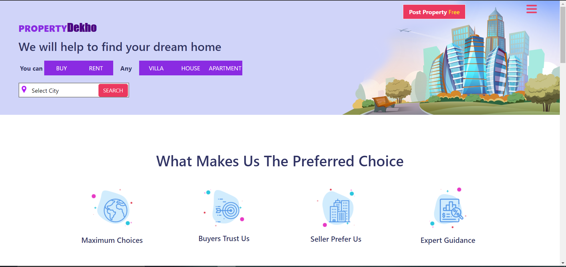
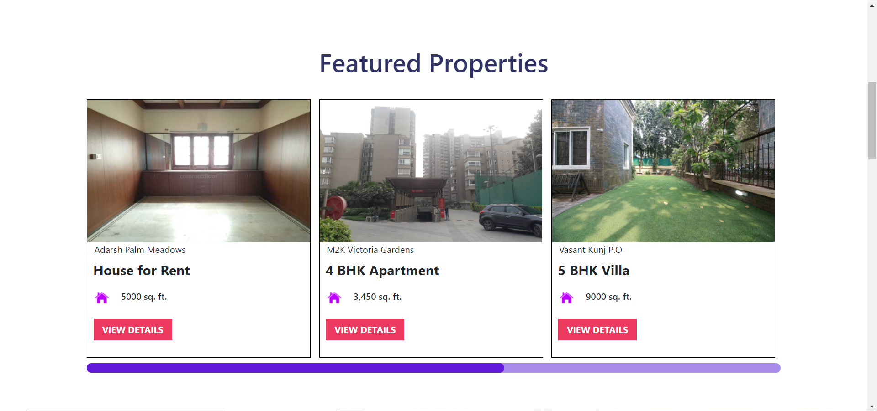
Project Screenshots

Slide 8
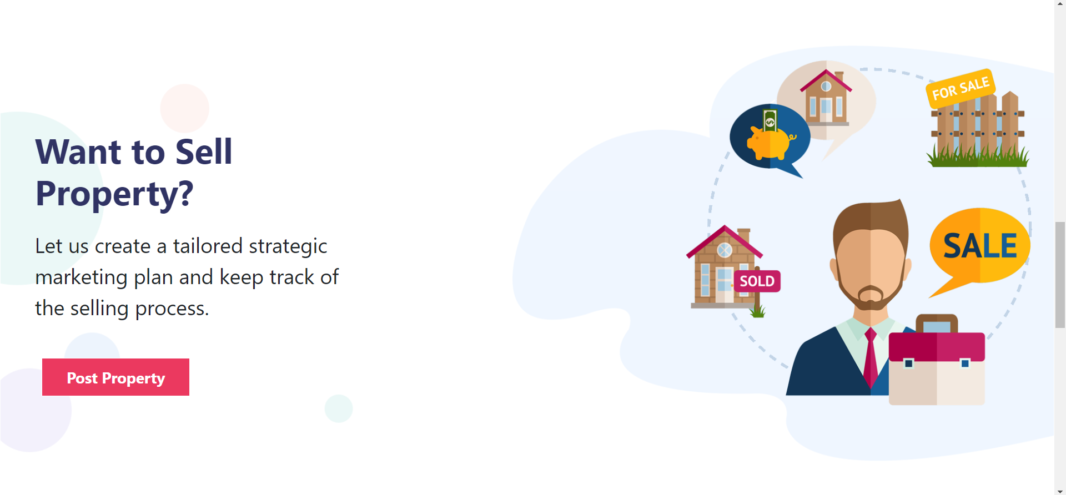
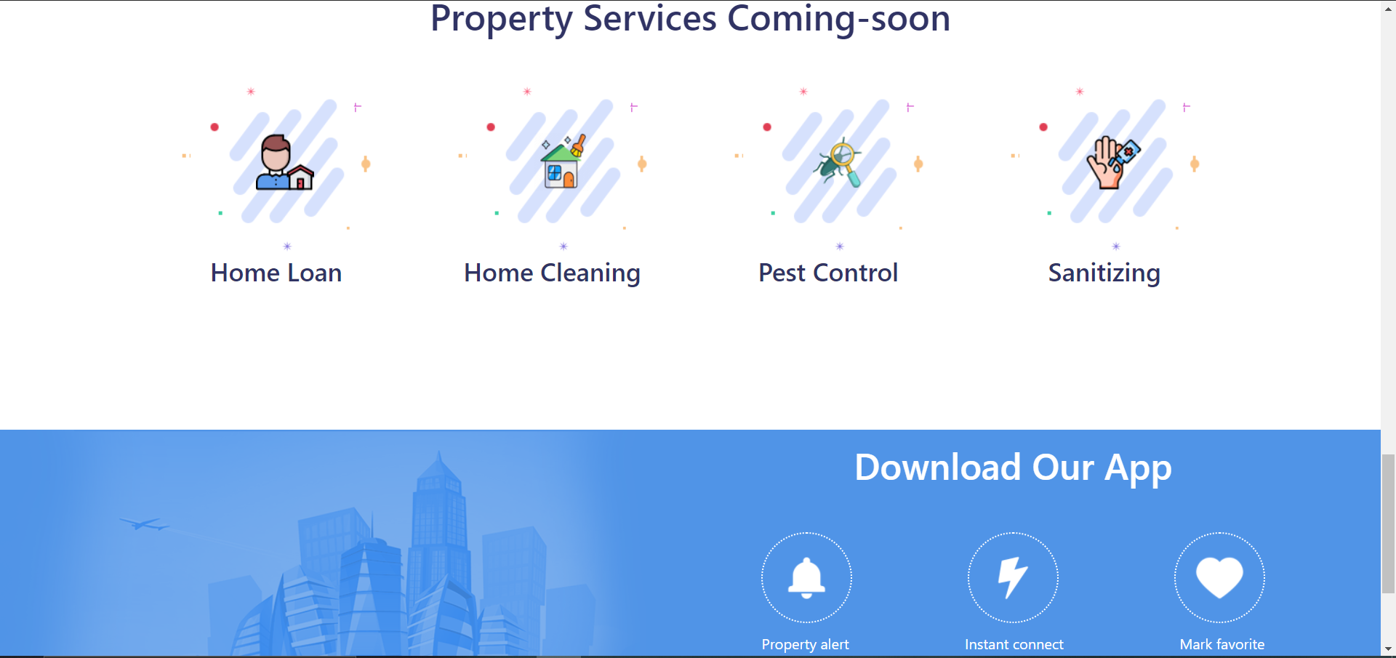

Slide 9
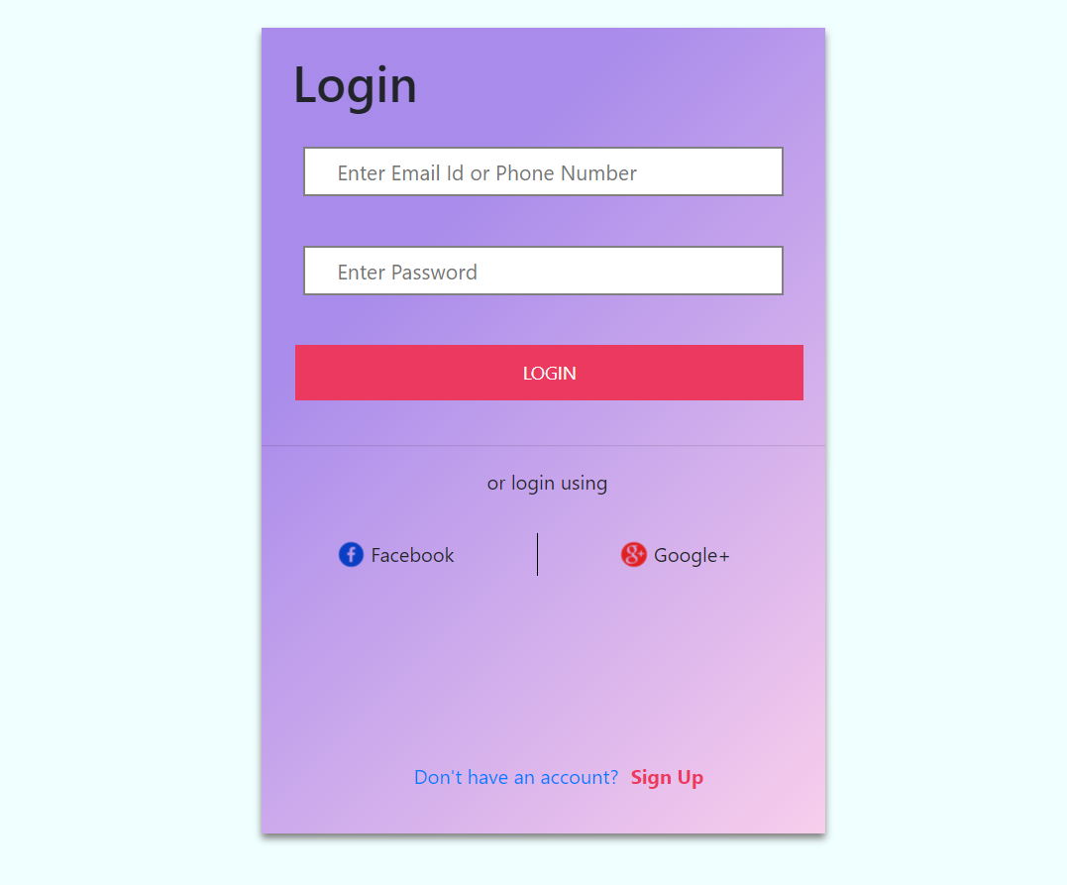
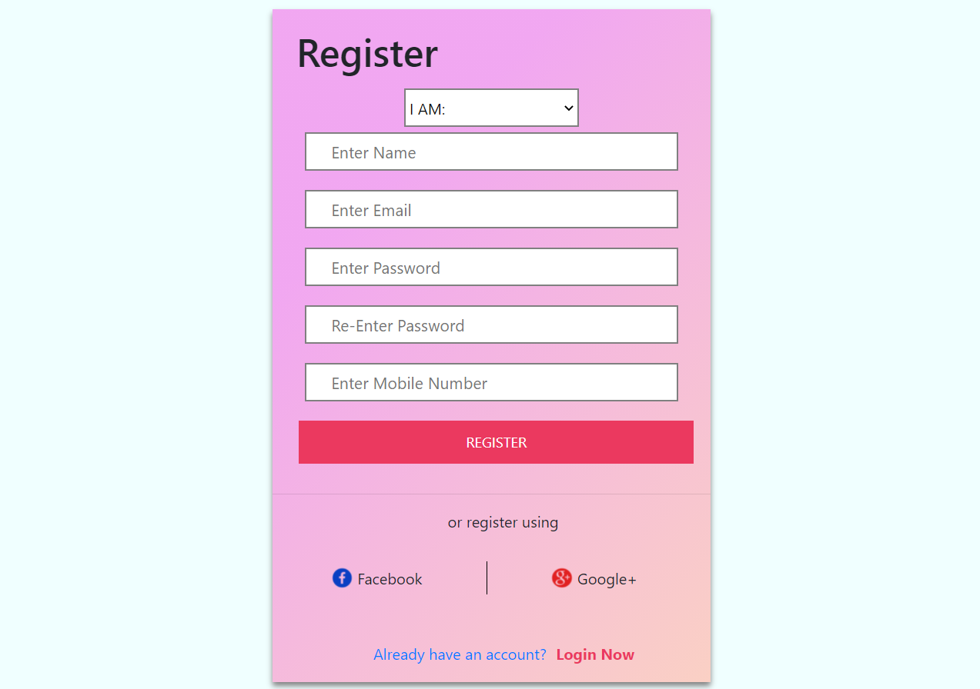
Login & Register

Slide 10
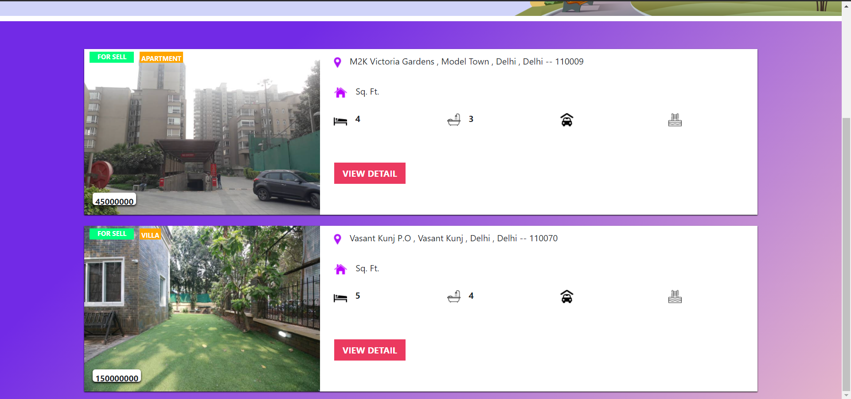
Searched Property

Slide 11
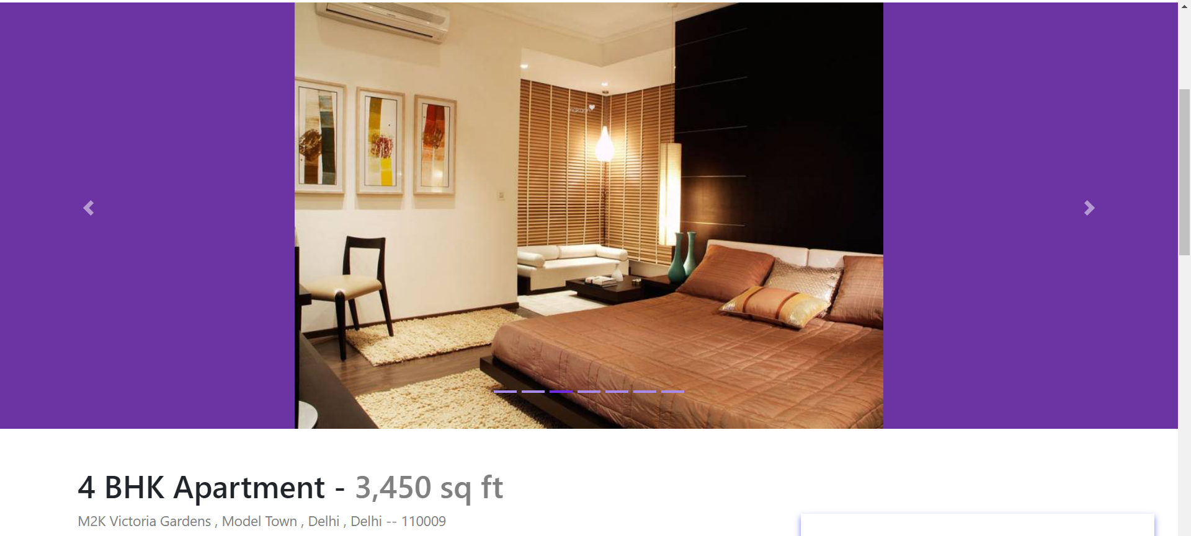
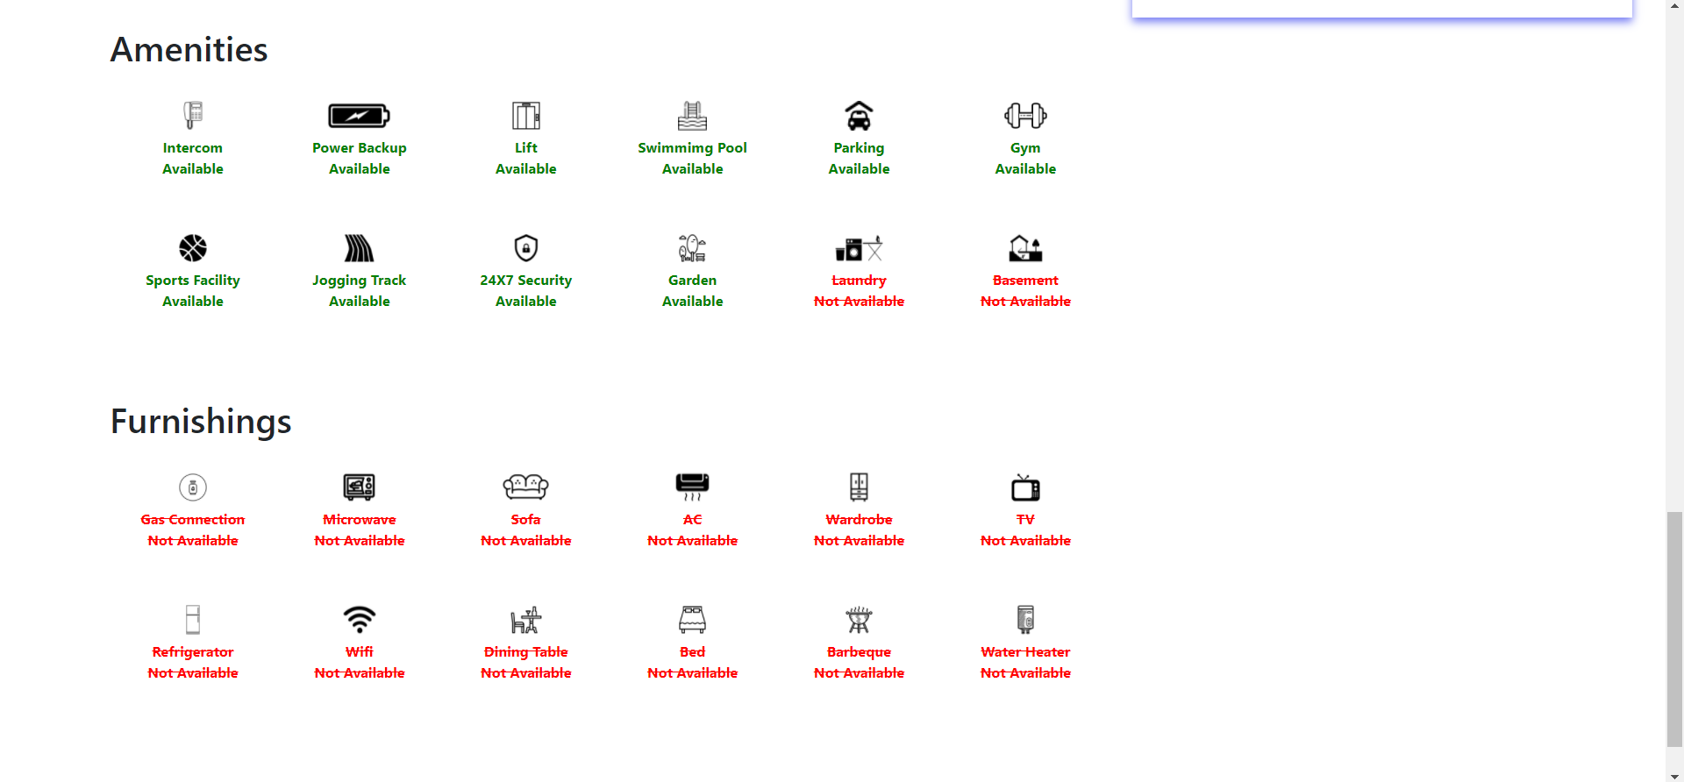
Property Details

Slide 12
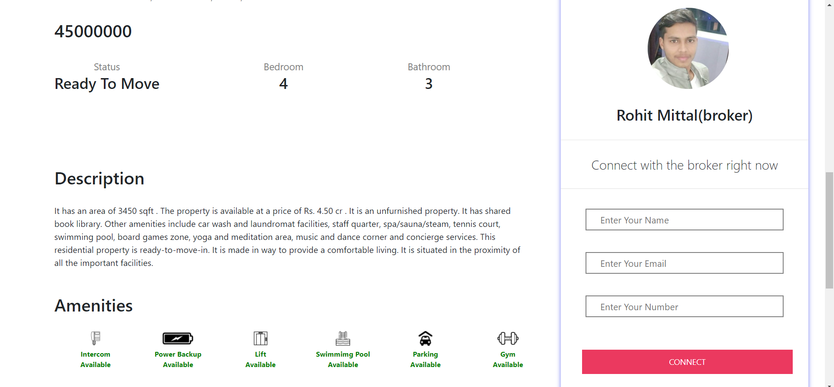
Enquiry Property

Slide 13
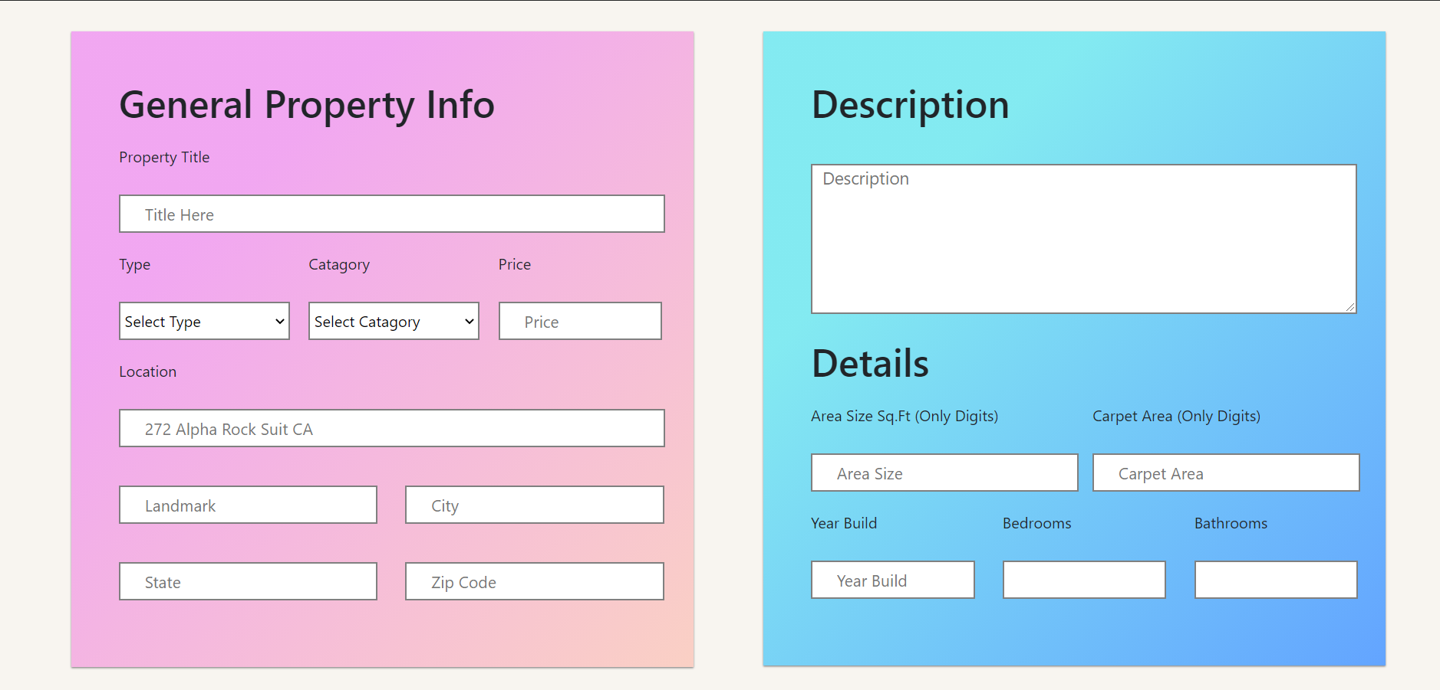
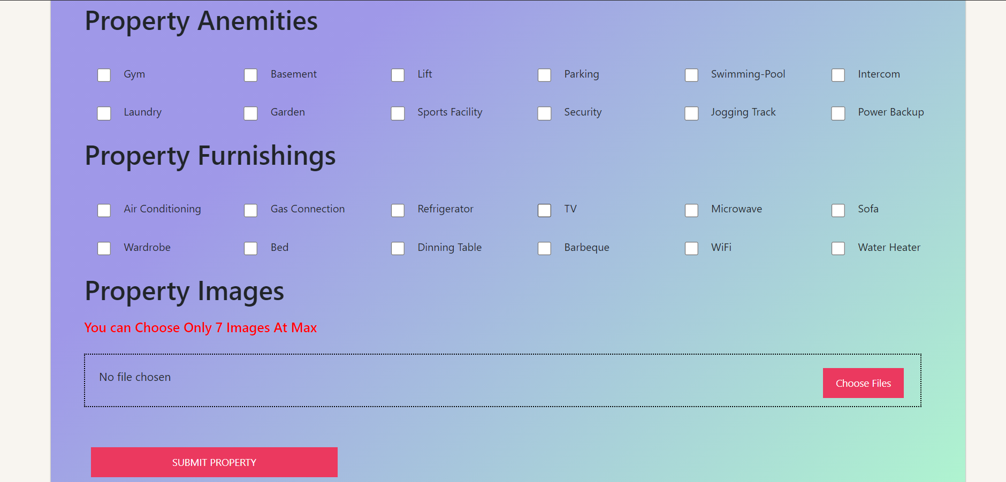
Post Property Form

Slide 14
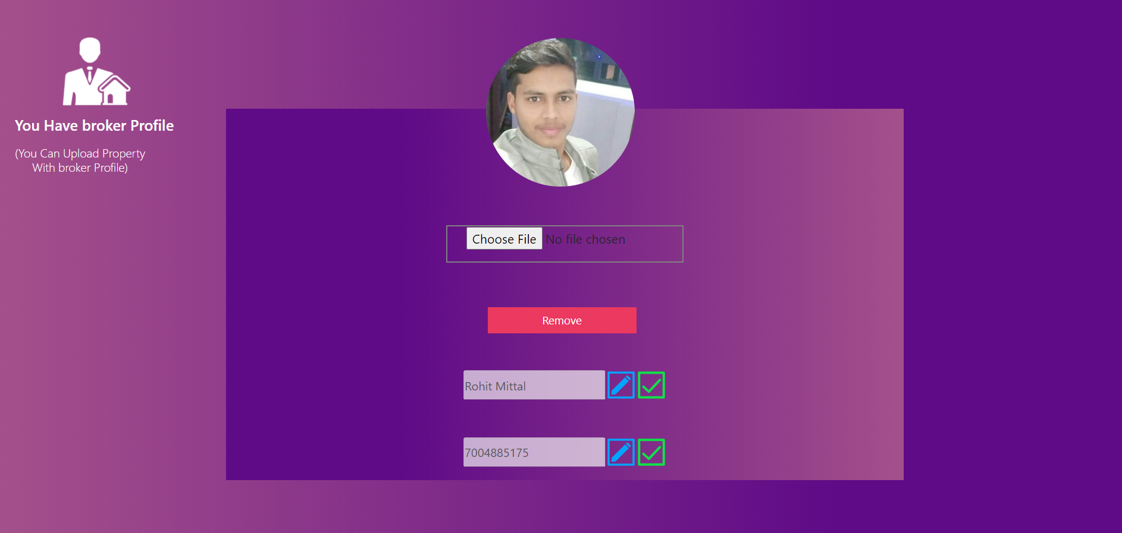
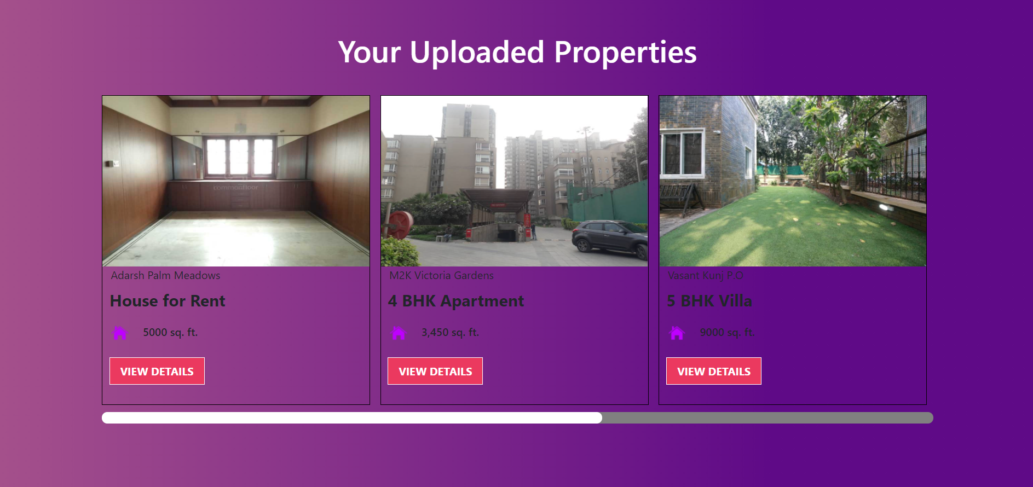
Dashboard

Slide 15
Future Scope
We will include more fuctionality as per the requirement.
We want to improve our home page, as it is the main thing which attracts all users.
Not a single website is ever considered as complete forever firstly because there is always something new requirement that are growing day-by-day

Slide 16
THANK YOU

